Slide 1
Paying For College
Student Accounts
Notes:
Paying for College at UB - Student Accounts
The Student Accounts office handles billing, payments, refunds, and 1098-T tax reporting.

Slide 2
eBill Notification
On December 27th,
You will ONLY receive this email, sent to your @buffalo.edu email address
You will NOT get a paper bill
mailed to you
From: UBeBill@buffalo.edu <UBeBill@buffalo.edu> Subject: Your University at Buffalo eBill is available online
Name: Victor E. Bull
ID #: 512345678
Invoice Amount: $ 396.75*
Your University at Buffalo electronic billing statement (eBill) is now available. You are receiving this notification due to potential new activity on your account such as charges, payments, refunds or Financial Aid activity. Any unpaid charges from the previous eBill will be brought forward, and additional charges, payments and credits will be shown. Paper bill statements are not being mailed to students. The payment due date and amount due can be found on your eBill. Anticipated aid is being used to reduce the amount due.
Your eBill reflects account activity as of 12/27/2023, the invoice date. Subsequent activity will not show on your eBill.
To view your eBill, current account activity or to make a payment:
Log into your HUB Student Center through myub.buffalo.edu.
In your Student Center, click on Billing / Payments tile.
You will then be brought into QuikPAY.
Click on View & Pay Accounts
A guide explaining how to read your student bill is available on the following website: buffalo.edu/studentaccounts/billing/access-and-read-your-bill
Notes:
HOW you know you have an eBill - Slide 2 eBill Notification. UB will send you an ‘eBill Notification’ email each time a billing statement is generated for you. You will ONLY receive this email, sent to your @buffalo.edu account. You will NOT receive a paper bill. The notification email is NOT your actual eBill. The body of the email message provides instructions how to navigate through HUB and QuikPay (QP) to view your actual eBill. The email notification will provide your name, UBID, Invoice Amount, and the invoice date. At the end of the message, it provides a link to a guide available on our website explaining how to read your student eBill.
WHEN will your fall 2022 bill be issued - The fall 2022 semester eBill will be generated on July 25th. The Amount Due must be paid in full by August 24th, or enroll in a payment plan by August 24th, to avoid a late payment fee.

Slide 3
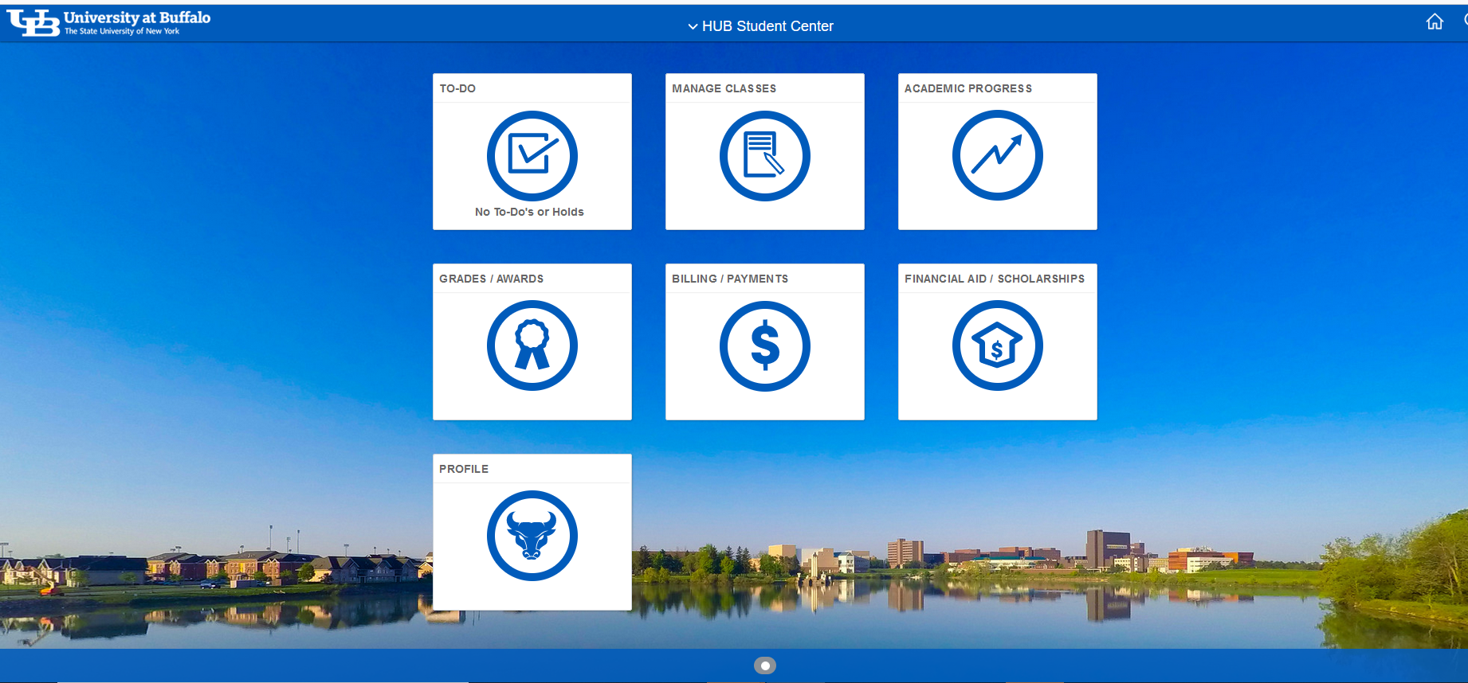
HUB STUDENT CENTER
Okay, how do I find my eBill?
Notes:
WHERE you will find your eBill - Slide 3 is a screenshot of your HUB Student Center. To view your eBill, please click on the Billing / Payments tile. This will take you to QuikPay (QP). Click on the ‘Payment Options’ button.

Slide 4
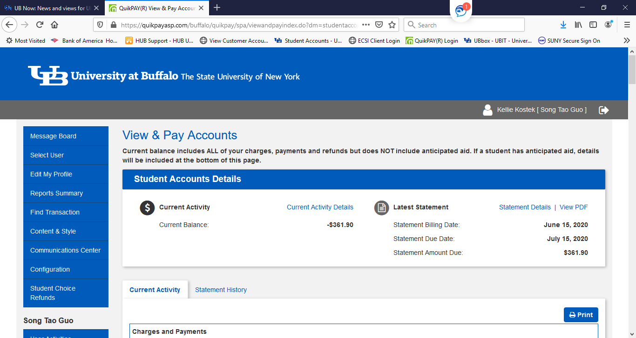
QUIKPAY – View & Print Your eBill
Bill Due by
January 24, 2024
$ 361.90
December 27, 2023
January 24, 2024
12/10/2022
12/10/2022
Payment on Account - eCheck
Payment on Account - CC
Fall 2022
Fall 2022
Notes:
WHERE you will find your eBill - Slide 4 shows you what QP looks like, noting the menu on the left side. Here you can view and/or print your eBill by clicking on the “View and Pay Accounts’ menu button. On the right side of the screen, your latest statement information is listed: Statement Billing Date, Statement Due Date, and Statement Amount Due. There is also a link to view the PDF of the billing statement.
As noted at the top of this QP screen, the Current Balance listed on this page does NOT subtract your anticipated financial aid. Anticipated financial aid is aid that has NOT actually posted to your student account. However, on your eBill, we do subtract your anticipated financial aid when calculating the Statement Amount Due. Lastly on this page, please note the ‘Current Activity’ and ‘Statement History’ tabs at the bottom. Under Current Activity, you will see transactions that have occurred AFTER your statement Invoice Date. The Current Activity is updated nightly. This is a good place to check if you have submitted a medical insurance waiver and you want to see the adjustment credited to your student account before the next billing statement is issued. The Statement History tab will have a record of every eBill that has been generated for you. You can refer back to these when filing income taxes so you do not need to print out each statement at the time it is generated.

Slide 5
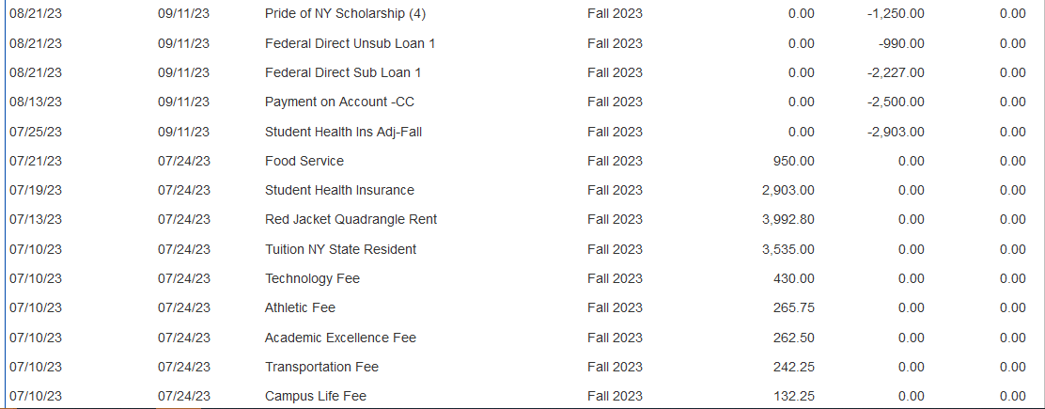
QUIKPAY – Current Activity
Your Current Account Activity Updates Daily

Slide 6
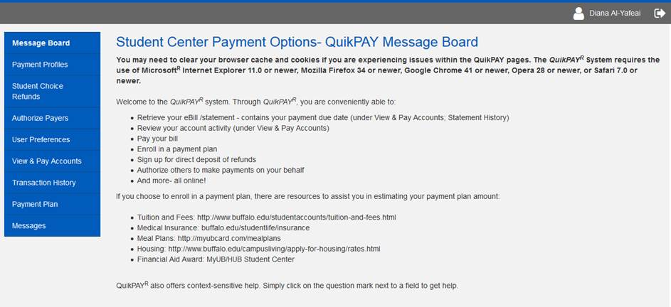
QUIKPAY – Authorized Payer Access
You may give access to spouse or family, to view & pay your bill
Notes:
WHO can access QuikPAY (QP) –Slide 7 shows a screenshot of QP. By clicking on the Authorized Payers menu button on the left, you are able to authorize family members and spouses to have access to your eBills, make payments to your student account, and to enroll in a payment plan. You can have multiple Authorized Payers, and you may rescind access at any time.

Slide 7
WHAT TO EXPECT ON YOUR eBill
CHARGES
Tuition (charge for actual credit hours registered)
Classes added on/after December 27th will appear on February 12th eBill.
Mandatory and Broad-based Fees
Class Fees
Meal Plan
Campus Housing
Student Health Insurance
Charged each fall and spring term to all full-time International students
If you have sufficient coverage, submit an ONLINE Waiver at https://buffalo.edu/studentlife/insurance
Submit the Waiver BEFORE 1/24/24 Payment Due Date to avoid late fees
Note: Billing is for one semester/term, not the full academic year.
*except for health insurance
Notes:
WHAT is on your eBill – Slide 5 explains what to expect on your eBill. UB will send you a billing statement for one semester at a time. We do not bill you for the entire year. In addition to your name, UB ID, Invoice Amount Due, and the Invoice date, you will see tuition and fee charges. UB will only charge you tuition for the credit hours you are registered for at the time of billing. If you plan to be full-time, but have not registered for all of your classes at the time the bill was generated, you will see your tuition and fee charges over the course of two billing statements.
All students will be charged the mandatory and broad-based fees, regardless of the mode of instruction. You may have classes on campus, remote or a hybrid, but the fee assessments are the same amount for all classes. You may see an additional fee on your account for those classes that require a lab fee or special charge. If you signed up for a meal plan or on campus housing, those charges for the fall semester only will be on your eBill. All full-time students are charged student health insurance annually on the fall semester eBill. If you have other insurance coverage, you need to submit a waiver online, see the URL on this slide and also on our website. Please submit the waiver request ASAP, and once approved the charge will be removed. If you do not request a waiver prior to the payment due date, you may receive a late payment fee. For those who are approved for a waiver will need to submit a waiver request every year.

Slide 8
WHAT TO EXPECT ON YOUR eBill
PAYMENTS AND ANTICIPATED FINANCIAL AID
Tuition and housing deposits will be deducted
Anticipated aid will be deducted to calculate amount due
Must complete To-Do List items for aid to show on your eBill.
If aid is cancelled due to ineligibility, might result in a balance.
Missing expected aid on your eBill?
Contact the Financial Aid office
Pay the amount due by due date to
avoid late payment fees.
Do not wait for a revised bill.
Holds will be placed on unpaid bills
after 60 days from bill date.
Notes:
On your billing statement, we will also deduct any payments such as deposits, and anticipated financial aid. Again, Anticipated financial aid is aid that has NOT actually posted to your student account. We will subtract these from your charges to calculate your Amount Due. In order for your financial aid to show on your eBill, you must complete all To-Do list items. Look for the To-Do list tile in your HUB Student Center. Check it regularly, as new items may be added at any time. If you do not see all of your financial aid listed on the eBill, and you do not have any outstanding To-Do items, please contact the Financial Aid office. You must pay the Amount Due on the eBill by the payment due date to avoid late payment fees and holds preventing university services. Do Not wait for a revised eBill.

Slide 9
HOW TO PAY YOUR eBill
ONLINE PAYMENTS
eCheck from your personal US bank account – be aware of your daily max limit
International Payments by Flywire - offers multiple payment options and excellent foreign exchange rates. They’ll ensure your payment arrives safely and accurately.
.
Credit Card – MasterCard, Visa, Discover, American Express
Credit card payments can only be made online
Spouse/Family need authorized payer access
No convenience fee
MAIL A PERSONAL CHECK
University at Buffalo
PO Box 10068
Albany, NY 12201-5068
Notes:
HOW to pay your bill – You have two options to pay your fall semester bill, either pay the statement amount due in full by the payment due date, OR enroll in a payment plan and spread the fall costs over several installment payments.
If you are paying the fall statement amount due in full, most people pay the bill online. You can pay with your personal US checking or savings bank account. Please check with your financial institution in advance of the payment due date, to find out if there is a daily maximum limit. If your amount due is $3,000 and your daily max is $500, it will take you several days to pay in full and you will end up with a late payment fee. Another very common method of payment is using a credit card. UB accepts the four major credit cards: MasterCard, Visa, Discover, and American Express. We do NOT charge a convenience fee like many other schools. Credit card payments can only be made online, by the card holder. This is for your payment card security. If a spouse or family member wants to make a payment, you will first need to grant them authorized payer access. For international students and families, the university partners with Flywire to process International Payments. Flywire offers multiple payment options and excellent foreign exchange rates. They’ll ensure your payment arrives safely and credited to your student account promptly.
You may also pay your bill by mailing a personal check to University at Buffalo, PO Box 10068, Albany, NY 12201-5068. This address will be listed on your eBill as well as our website.

Slide 10
QUIKPAY - How To Make a One Time Payment
December 27, 2023
January 24, 2024
This is the only way you can pay with a credit card
If you are enrolled in a payment plan,
do not use “Make a Payment” button

Slide 11
HOW TO PAY YOUR eBill
PAYMENT PLAN
Pay the bill in installments by enrolling in a Payment Plan
HOW? Enroll Online!
WHEN?
For 5 installments, enroll Dec. 15 – Jan. 14
For 4 installments, enroll Jan. 15 – Feb. 14
For 3 Installments, enroll Feb. 15 – Mar. 1
PLAN DETAILS
$45 enrollment fee
Offered fall and spring terms only
Interest-free, not a loan program
You provide payment account when you enroll
Installments automatically taken out on payment due date
Can change payment account as often as you’d like
On a payment plan, you’ll receive email reminders about upcoming payments and changes in installment amount.
Notes:
Enrolling in a payment plan is a payment option to help you break up the fall balance into several installments. It is also an option to pay for spring semester too, but you must re-enroll. You or your authorized payer use QP to enroll in the payment plan. The day you enroll determines how many installments you will have. Please see our website for the specific enrollment dates. There is a $45 non-refundable enrollment fee. During enrollment, you will provide a payment account, either a US bank account or credit card, for your Installments to automatically be taken out on installment dates. You may log in to QP to change your payment account as often as you’d like. You will receive email reminders about upcoming payments and changes in installment amounts. Please visit our website to get more information about the payment plan.

Slide 12
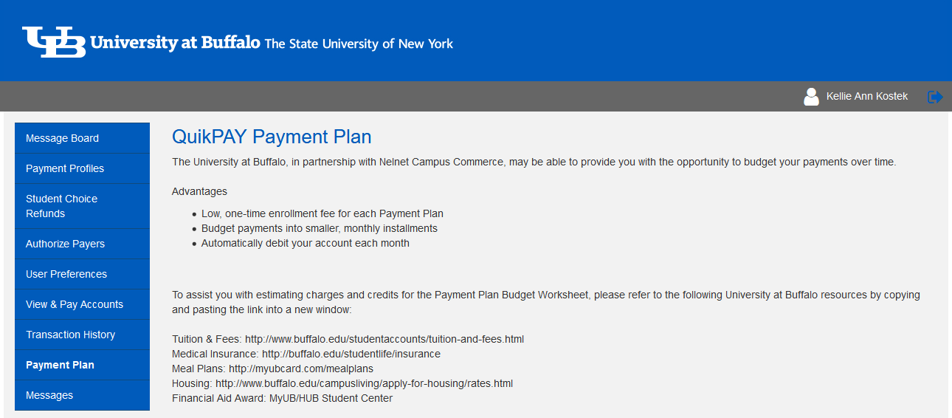
QUIKPAY - Enroll in a Payment Plan
Spring 2024 Payment Plan Enrollment Begins December 15th
Last Day to enroll in Payment Plan is March 1, 2024
Notes:
Slide 12 shows a screenshot of QP, just click on the Payment Plan button on the menu to begin the enrollment process. You will complete a budget worksheet to determine your costs for the fall plan.

Slide 13
QUIKPAY - Enroll in Direct Deposit
Students Receiving a Refund
Refund is available to you much faster – within 48 business hours
Safeguard against lost or stolen checks
Notes:
REFUNDS - We highly recommend you enroll in direct deposit for your financial aid refunds today! You will get your refund much faster and safeguard against lost or stolen checks. Refunds are generally available in your personal bank account within 48 business hours. If you are not enrolled, it will take up to two weeks for us to mail a paper check. Please keep your local and permanent addresses in HUB up to date. Slide 13 shows the page in QP to enroll in direct deposit of your financial Aid refunds. On the menu, click on ‘Manage Refunds’, then click on ‘Manage My Refunds’ in the middle of the page. Here you will provide your personal bank account information.
Hundreds of students don’t cash their refund checks, either forget to do it or never receive it. Don’t let this be you, enroll in direct deposit today!

Slide 14
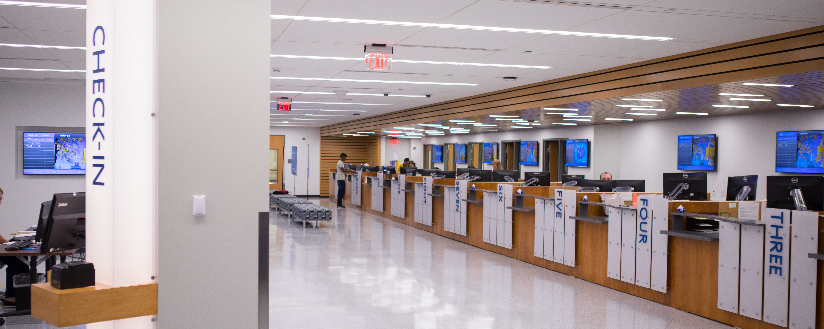
STUDENT ACCOUNTS
Visit Us In Person at 1Capen
Call Us (716) 645 – 1800
Chat with Virtual Vic or Contact Us at https://www.buffalo.edu/studentaccounts.html
Notes:
You may also visit 1Capen for in-person service. Please visit our website at http://www.buffalo.edu/studentaccounts.html. Virtual Vic is on our website to help answer your questions. Contact Student Accounts by phone at (716) 645 – 1800.

